Slide 1


Exploratory Data Analysis of
Insurance Dataset
By
Mounika
Data Analyst Intern
Under Guidance:
RAPAKA MANOJ KUMAR

Slide 2
INTRODUCTION
The Insurance dataset contains information about individuals and their medical insurance costs.
It consists of 1338 records and 7 variables.
The dataset includes both numerical and categorical data types.
It is commonly used for exploratory data analysis (EDA) and cost prediction.
The main target variable is insurance charges.

Slide 3
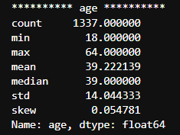
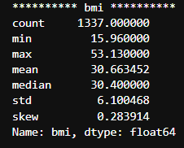
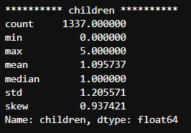
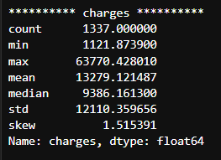
Data Overview
Numerical Columns

Slide 4
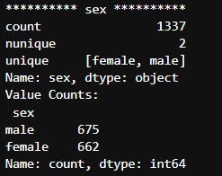
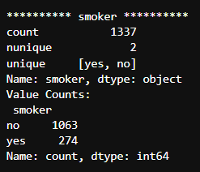
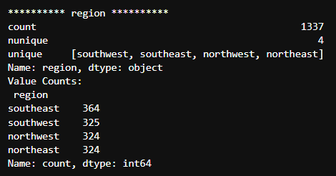
Data Overview
Categorical Columns

Slide 5
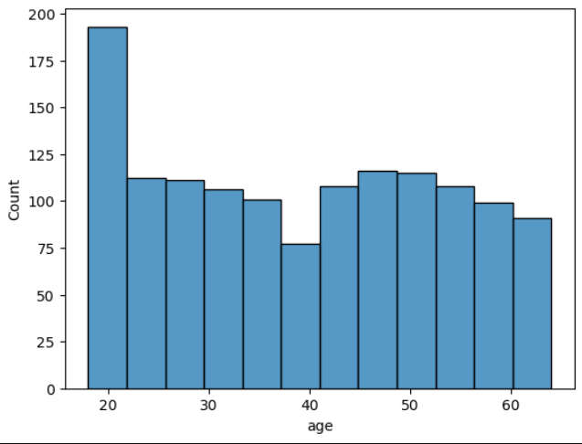
Count and Age
The dataset contains 1,338 total records.
Age ranges from 18 to 64 years.
The average age is around 39 years.
Most individuals fall in the young to middle-aged group (25–50 years).
Insurance charges generally increase as age increases, especially after middle age.

Slide 6
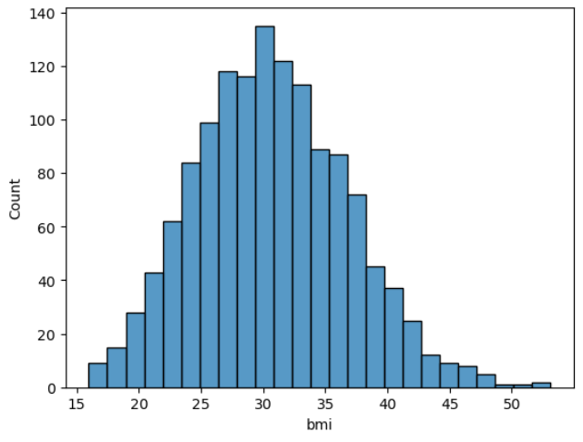
Count and BMI
BMI values mostly lie between 25–35.
Majority of people are in the overweight range.
Very high BMI values are less common.
Extreme BMI may lead to higher insurance costs.

Slide 7
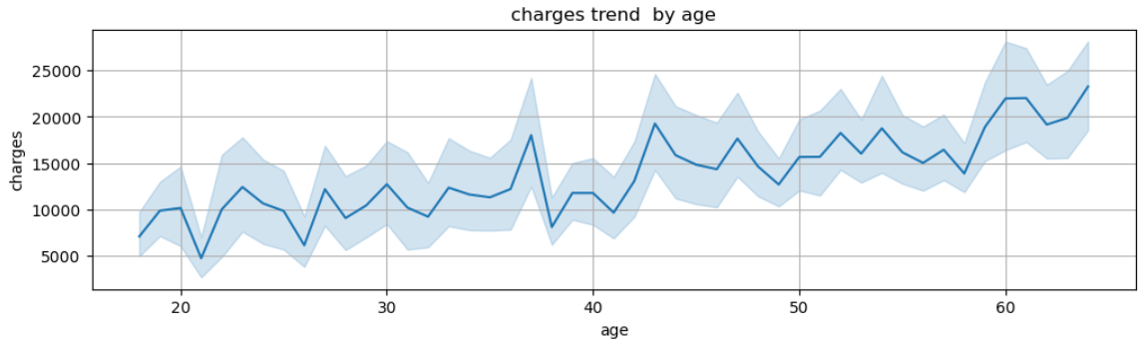
Age and Charges
Medical charges increase as age increases
Younger ages show lower and more stable charges
Older age groups have higher charges with more variation
Indicates a positive correlation between age and insurance charges
Health risks and medical needs rise with age, increasing costs

Slide 8
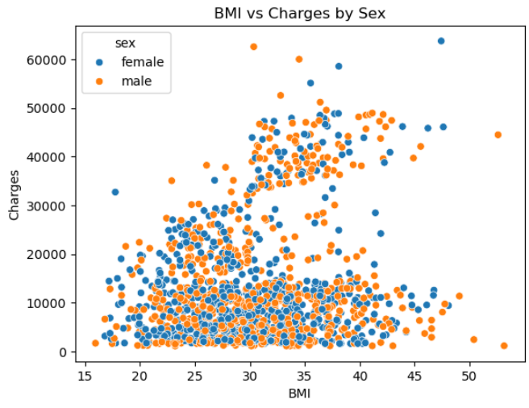
BMI and Charges
Medical charges increase as BMI increases
People with higher BMI tend to have higher healthcare costs
At lower BMI values, charges are more concentrated and lower
Higher BMI shows greater variation in charges
Indicates a positive relationship between BMI and insurance charges

Slide 9
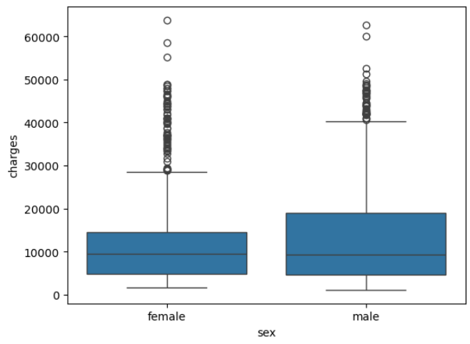
Gender and Charges
The box plot compares medical charges between males and females
Median charges for both sexes are relatively similar
Males show a slightly wider spread in charges
Presence of outliers indicates very high medical costs in both groups
Sex alone has less impact on charges compared to factors like age or smoking

Slide 10
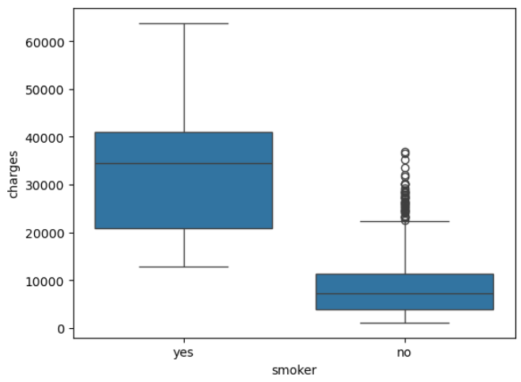
Smoker and Charges
Smokers have significantly higher medical charges than non-smokers
Non-smokers’ charges are mostly lower and more concentrated
Smoking shows a strong positive impact on insurance costs
Smokers also show greater variation in charges
Indicates smoking is a major risk factor affecting medical expenses

Slide 11
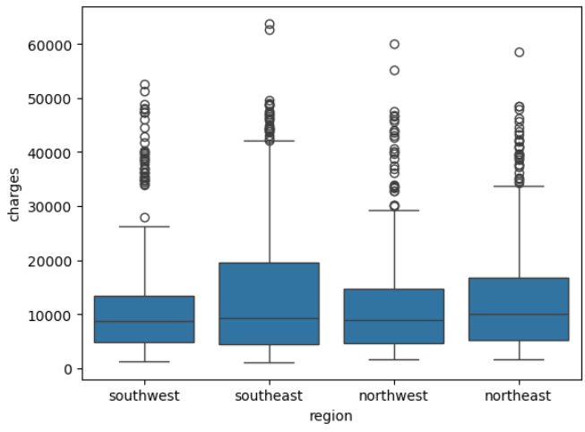
Region and Charges
Medical charges are distributed across all regions
No single region shows consistently highest charges
Charges vary widely within each region
Overlap indicates region alone does not strongly affect charges
Other factors (age, BMI, smoking) impact charges more than region

Slide 12
Insights
Most individuals fall in the overweight BMI range (25–35).
Very high BMI values are rare but present.
BMI values are clustered around the average (~30).
Higher BMI is linked to higher insurance charges.
Underweight cases are very few.
The distribution shows a slight right skew.

Slide 13
Recommendations
Apply higher premiums for smokers and provide incentives for quitting smoking.
Use age-based pricing slabs to better reflect increasing medical risk with age.
Introduce wellness programs for customers with high BMI to reduce long-term costs.
Offer family plans for customers with children to improve affordability.
Focus less on gender-based pricing, as it has minimal impact on charges.
These steps can help optimize pricing, reduce claims, and promote healthier customers.

Slide 14
Conclusion
Smoking is the primary factor driving high insurance charges.
Age and BMI significantly influence medical insurance costs.
Gender and region have minimal impact on charges.
Number of children has a small effect on insurance expenses.
Overall, lifestyle and health factors matter more than demographic factors.

Slide 15
Thank You

